Slide 1
Thank you! Chapter - 3

Slide 2
MEASURES OF CENTRAL TENDENCY

Slide 3
Introduction and objectives of measuring central tendency
In the pervious section, we have discussed how raw data can be organized in terms of tables, charts and frequency distributions in order to be easily understood and analyzed.
Frequency distributions and their corresponding graphical displays roughly tell us some of the features of a data set.
However, they don’t condense the mass of data in a way that we can easily understand and interpret.
In this section, we will see how to summarize data using a descriptive measure called average. This will help us in condensing a mass of data into a single value which is in some sense representative of the whole data set.

Slide 4
An average is a single value intended to represent a distribution as a whole.
Note that the individual values of the distribution must have a tendency to cluster around an average. In view of this requirement an average is also referred to as a measure of central tendency.

Slide 5
An average (a measure of central tendency) is considered satisfactory if it possesses all or most of the following properties. An average should be:
Rigidly defined (unique),
Based on all observation under investigation
Easily understood,
Simple to compute
Suitable for further mathematical treatment
Little affected by fluctuations of sampling
Not highly affected by extreme values.

Slide 6
The summation notation
Suppose a variable is represented by X. The successive values of this variable may be represented by using subscripts or indexes as x₁, x₂, x₃,…, x_{n}. If the sum of these values or terms is required, we write x₁+x₂+x₃+…+x_{n}. The Greek letter ∑ (read as sigma) can be used to write the above sum in a compact form as
where 1= lower limit and n = upper limit.

Slide 7
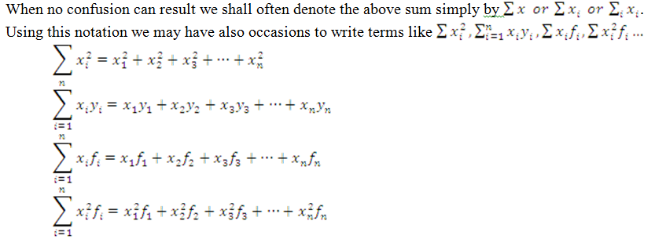

Slide 8
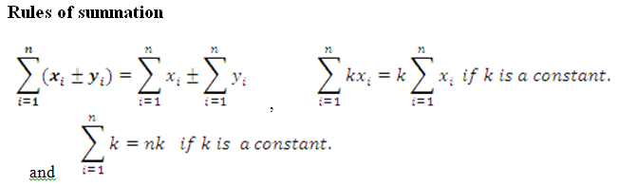

Slide 9
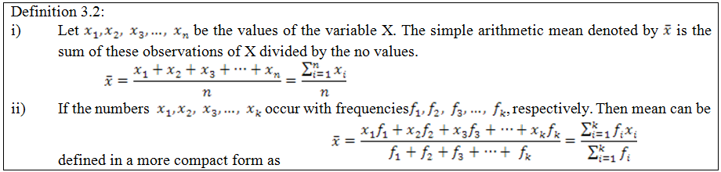
Types of measures of central tendency
Arithmetic mean
Note that if the data refers to a population data the mean is denoted by the Greek letter µ (read as mu).

Slide 10

Arithmetic mean for raw data (ungrouped data)
Example 3.1: The following data is the weight (in Kg) of eight youths: 32,37,41,39,36,43,48 and 36. Calculate the arithmetic mean of their weight.

Slide 11
Example 3.2: The ages of a random sample of patients in a given hospital in Ethiopia is given below:
Calculate the average age of these patients.
Solution:
Age | 10 | 12 | 14 | 16 | 18 | 20 | 22
Number of patients | 3 | 6 | 10 | 14 | 11 | 5 | 4

Slide 12
Age (x_{i}) | Number of patients (f_{i}) | fixi
10 | 3 | 30
12 | 6 | 72
14 | 10 | 140
16 | 14 | 224
18 | 11 | 198
20 | 5 | 100
22 | 4 | 88
Total | 53 | 852

Slide 13
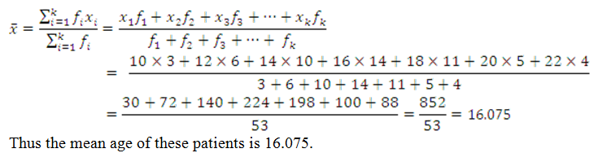

Slide 14
The weighted arithmetic mean
In some cases the data in the sample or population should not be weighted equally, and each value weighted according to its importance.
There is a measure of average for such problems known as weighted Arithmetic mean.
Weighted arithmetic mean is used to calculate the average when the relative importance of the observations differs.
This relative importance is technically known as weight.
Weight could be a frequency or numerical coefficient associated with observations.

Slide 15
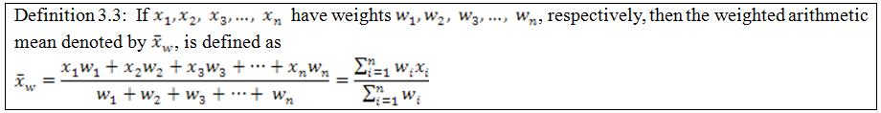

Slide 16
Example 3.3: The GPA or CGPA of a student is a good example of a weighted arithmetic mean. Suppose that Solomon obtained the following grades in the first semester of the freshman program at AASTU in 2006.
Course | Credit hour (w_{i}) | Grade
Math101 | 4 | A=4
Stat2091 | 3 | C=2
Chem101 | 3 | B=3
Phys101 | 4 | B=3
Flen101 | 3 | C=2

Slide 17

Find the GPA of Solomon.

Slide 18

Properties of arithmetic mean
It can be computed for any set of numerical data, it always exists, and unique.
It depends on all observations.
The sum of deviations of the observations about the mean is zero i.e.

Slide 19
It is greatly affected by extreme values.
It lends itself to further statistical treatment, for instance, combinations of means.
It is relatively reliable, i.e. it is not greatly affected by fluctuations in sampling.
The sum of squares of deviations of all observations about the mean is the minimum

Slide 20
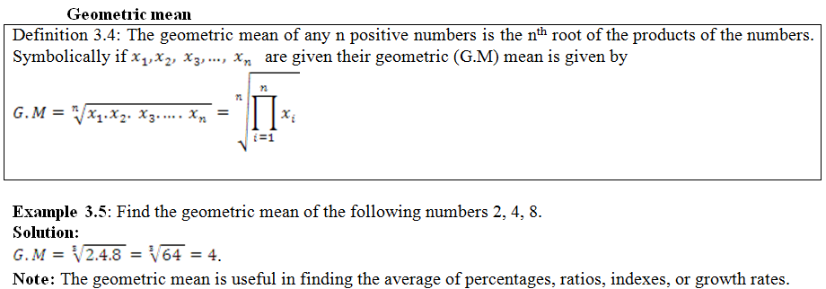

Slide 21
Example 3.6: During the beginning of an epidemic in a region 12 cases were reported in the first day, 18 on second day and 48 on the third day.
Find the average growth rate of the epidemic disease.
Assuming that the growth pattern continues, forecast the number of cases that would be reported on the 4th and 8th days.
Solution:
Find the 2 growth rates first.
From first day to second day the rate is 18/12=1.5.
From second day to third day the rate is 48/18=2.67.

Slide 22

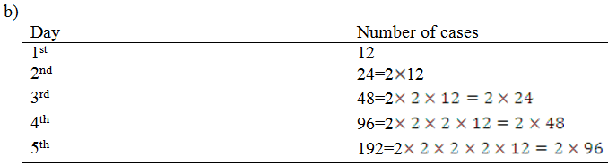
Therefore, the average rate
.

Slide 23
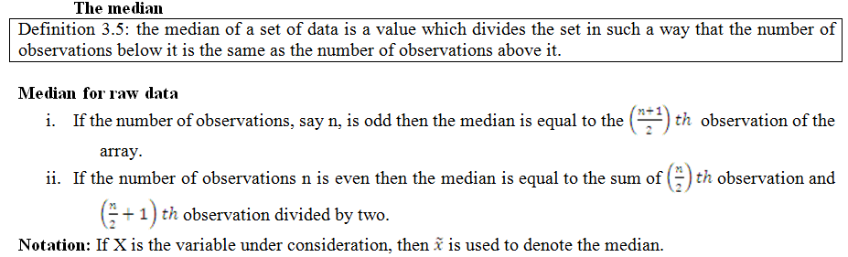
The Median

Slide 24
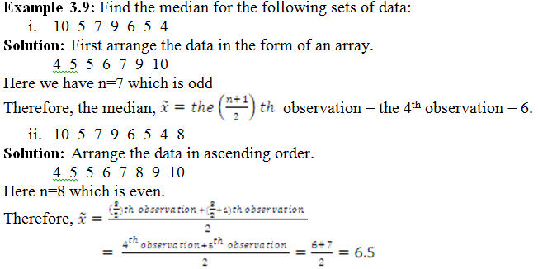

Slide 25
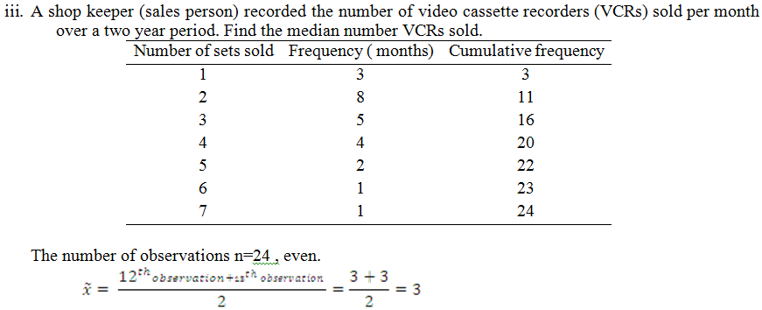

Slide 26
Properties of median
It is an average of position.
It is affected by the number of observations than by extreme values.
The sum of the deviations about the median, signs ignored, is less than the sum of deviations taken from any other value or specific average.

Slide 27
The Mode
Definition 3.6: The mode (modal value) of an observed set of data is the value that occurs the largest number of times.
The mode for raw data
Example 3.10: Find the modal value for the following sets of data.
5 6 5 8 7 4 . In this data set, 5 is the most frequent value. Therefore, the mode is 5. Since the modal value is only one number, we call the distribution unimodal.
1 2 3 4 8 2 5 4 6. In this data the modal values are 2 and 4 since both 2 and 4 appear most frequently and they occur equal number of times. These kind distributions are called bimodal distribution.
1 2 4 3 5 6 8 7 In this data set, all values appear equal number of times so there is no modal value

Slide 28
Note:
If a distribution has more than two modal values then we call the distribution multimodal.
If in a set of observed values, all values occur once or equal number of times, there is no mode.

Slide 29
Properties of modal value
It is easy to calculate and understand.
It is not affected by extreme values.
It is not based on all observations.
Is not used in further analysis of data.

Slide 30
The mean, median, and mode of grouped data
The mean for grouped data can be found by considering the values in the interval are centered at the mid-point of the interval.
Example 3.12: Consider the frequency distribution of the time spent by the automobile workers. Find the mean time spent by these workers from this frequency distribution.

Slide 31
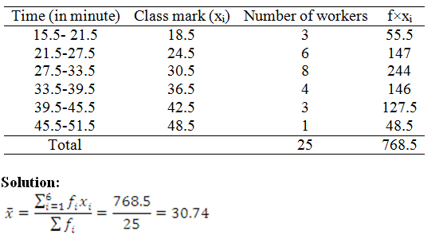

Slide 32
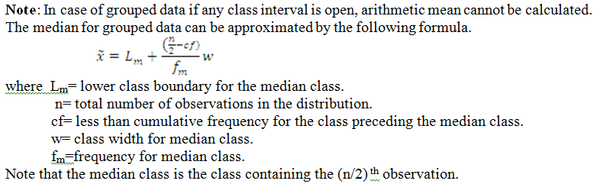

Slide 33
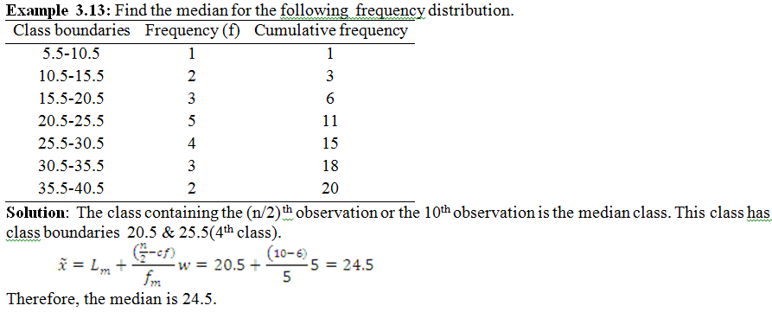

Slide 34
Note:
We approximate the median by assuming that the values in the median class are evenly distributed.
We can compute the median for open-ended frequency distribution as long as the middle value does not occur in the open-ended class.

Slide 35
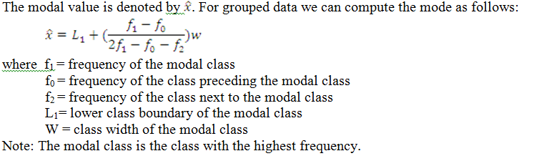
The mode for grouped data can be estimated by the following formula.

Slide 36
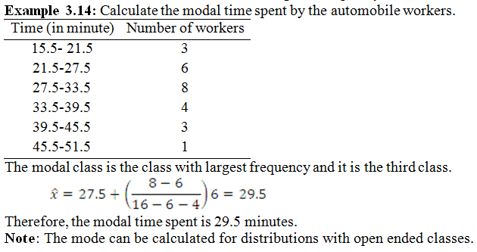

Slide 37
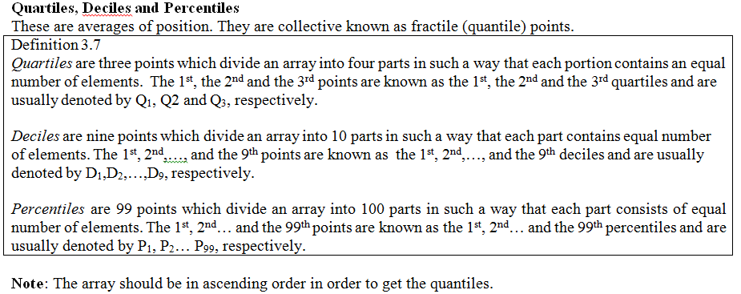

Slide 38
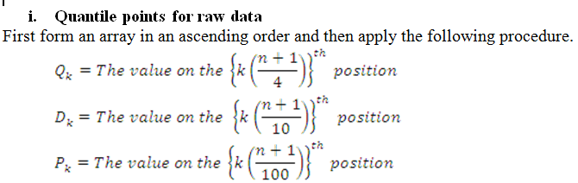

Slide 39
Example 3.15: The following data relate to sizes of shoes sold at a stock during a week. Find the quartiles, the seventh decile and the 90th percentile.
Solution: The total number of observations is 191.
Size of shoes | 5 | 5.5 | 6 | 6.5 | 7 | 7.5 | 8 | 8.5 | 9 | 9.5
Number of pairs | 2 | 5 | 15 | 30 | 60 | 40 | 23 | 11 | 4 | 1

Slide 40
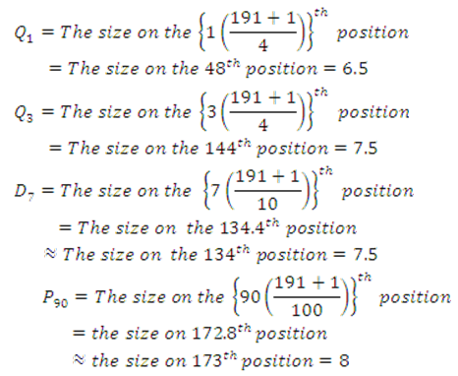

Slide 41
Note: Relationships between fractile points
Q₁=P₂₅
Q₂=P₅₀=D₅
Q₃=P₇₅
D₁=P₁₀; D2=P₂₀ …D₉=P₉₀.

